Slide 1


MEDICAL CANNABIS
Legislation and Practice Related to Medical Marijuana in the Legal Profession

Slide 2

THE REALITIES OF
MEDICAL CANNABIS IN
WEST VIRGINIA

Slide 3


CANNABIS AT WORK:
USING, MANAGING, AND NAVIGATING
MEDICAL CANNABIS IN THE WORK PLACE

Slide 4
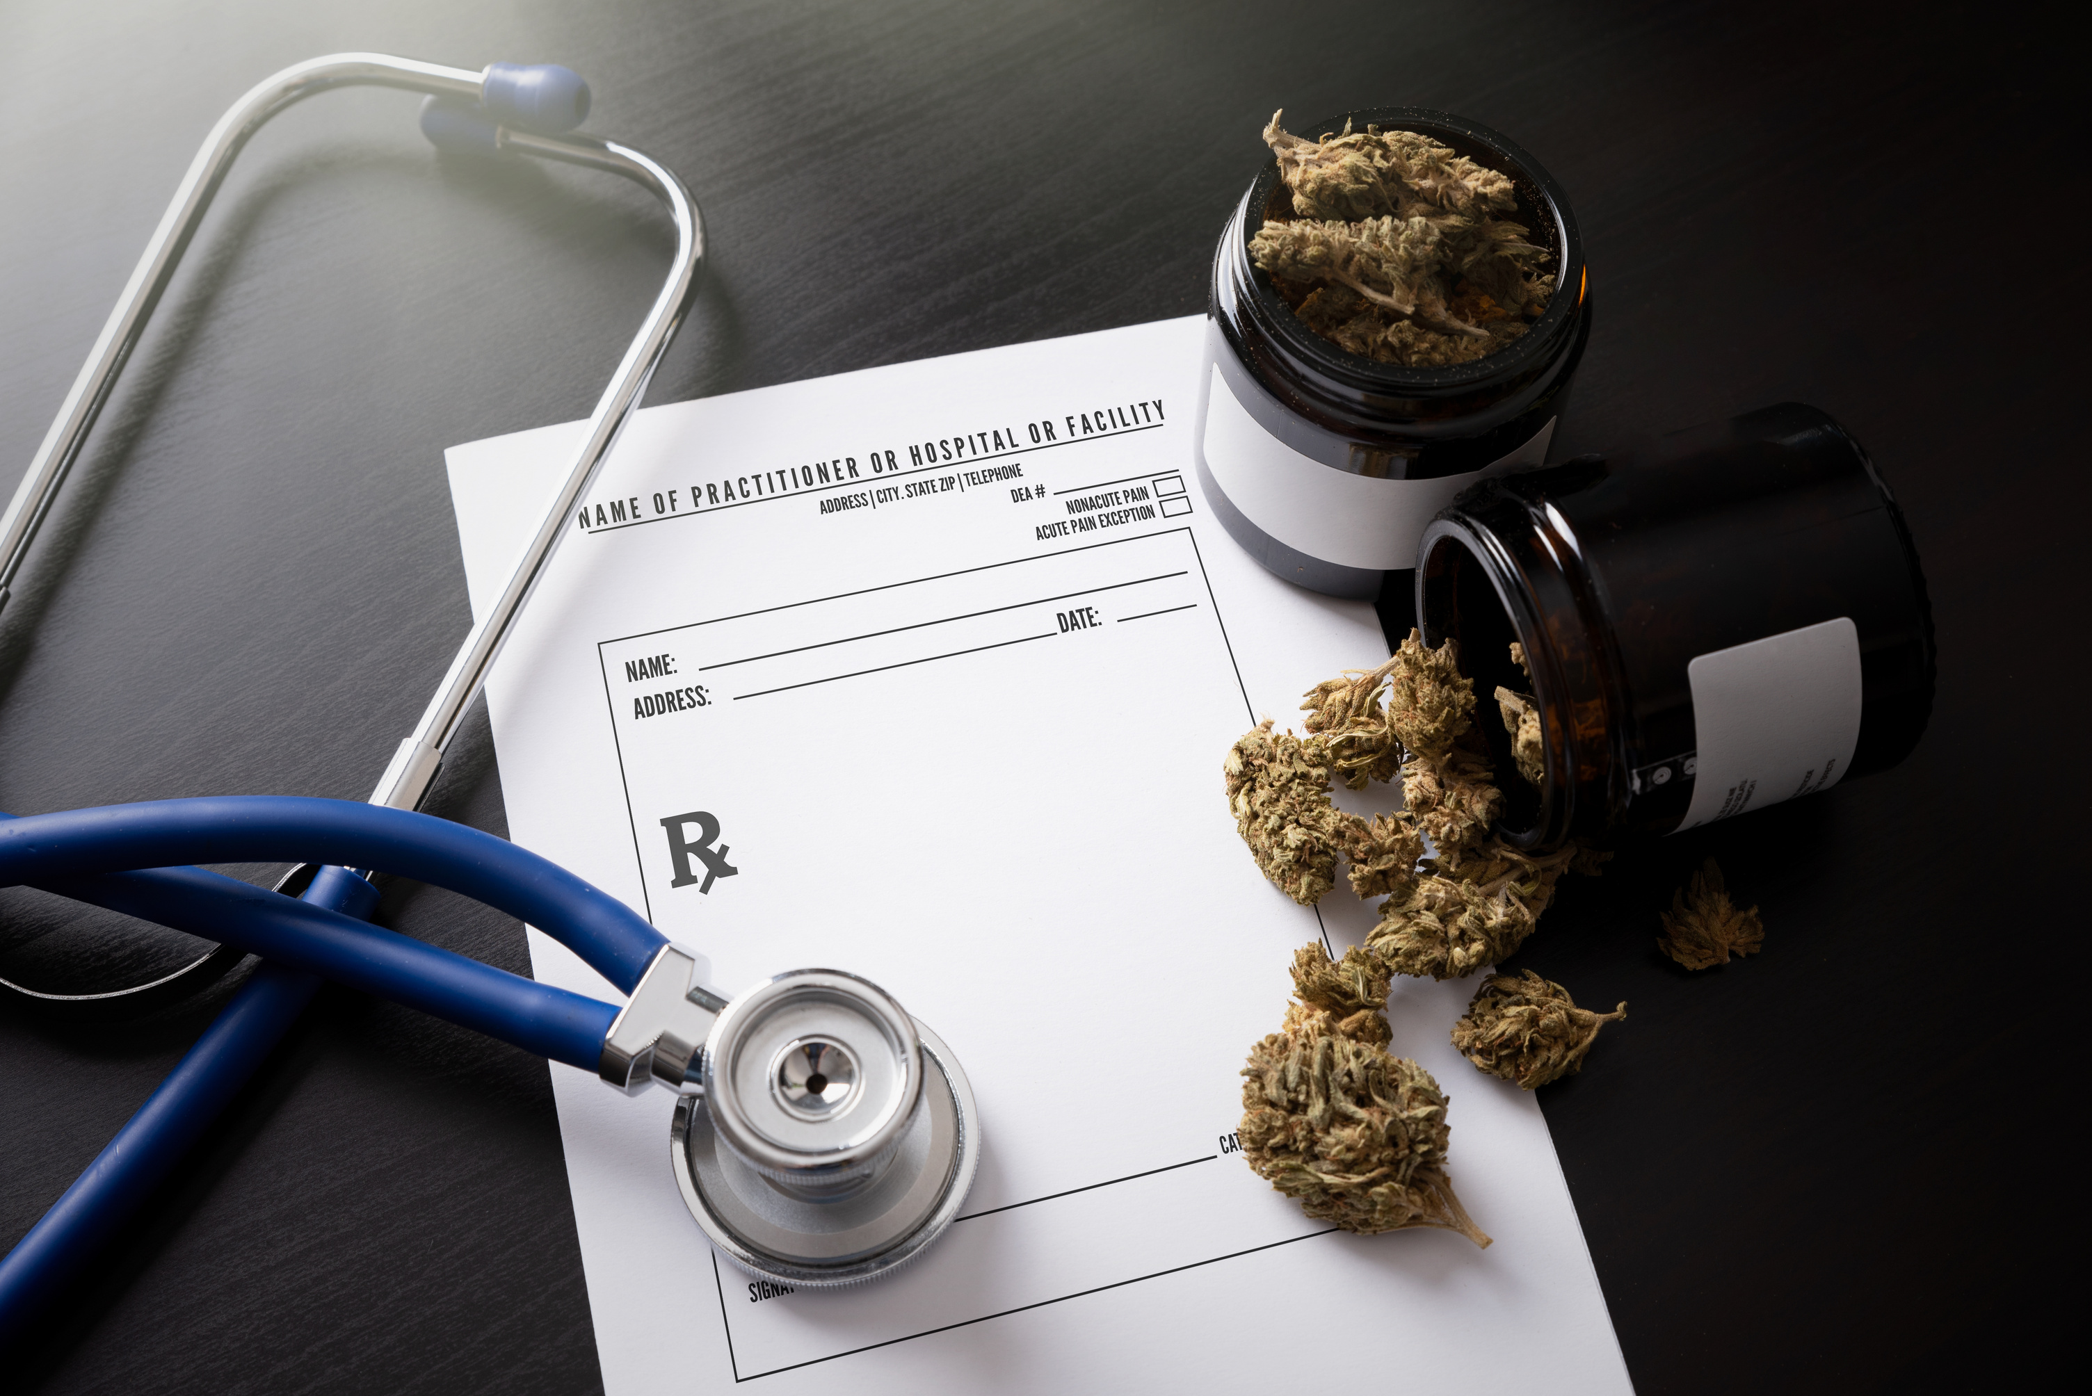
IT’S MEDICINAL!
IN AND AROUND THE LEGALITIES
OF MEDICAL CANNABIS CARDS

Slide 5


NAVIGATING MEDICAL CANNABIS IN DRUG COURT

Slide 6

GOING GREEN
THE FUTURE OF MEDICAL CANNABIS IN WEST VIRGINIA

Slide 7

ASK THE EXPERTS
WHAT QUESTIONS DO YOU HAVE ABOUT MEDICAL CANNABIS
IN THE
LEGAL PROFESSION?

