Slide 1
Federal v. State Court Practice
Presented By:
United States Magistrate Judge Michael John Aloi
United States Magistrate Judge Omar J. Aboulhosn
U.S. District Court for the Northern District of West Virginia
Clarksburg and Elkins
Former State Circuit Court Judge for Marion County
U.S. District Court for the Southern District of West Virginia
Beckley and Bluefield
Former State Circuit Court Judge for Mercer County

Slide 2
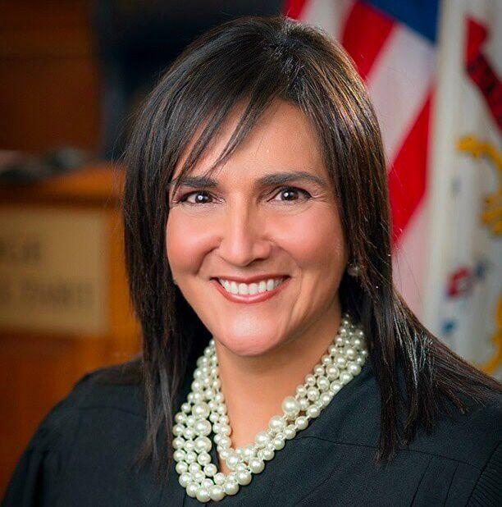
The Honorable
Joanna I. Tabit
Judge of the Circuit Court
Of Kanawha County
March 15, 1961
**
September 29, 2023

Slide 3
U.S. Federal District Court
The court of original jurisdiction for most cases decided by the federal courts.
There are 94 US District Courts – at least one in each state
The subject matter of the court’s jurisdiction extends to (primarily)
Federal crimes¹
Civil disputes arising under federal law²
Civil disputes between citizens of different states where the claims exceed $75,000³
Federal courts are courts of limited jurisdiction.
¹ See 18 U.S. Code § 3231 (“The district courts of the United States shall have original jurisdiction, exclusive of the courts of the States, of all offenses against the laws of the United States.”)
² See 28 U.S.C. § 1331 (Federal Question Jurisdiction).
³ See 28 U.S.C. § 1332 (Diversity Jurisdiction). See also 28 U.S.C. § 1367 (Supplemental Jurisdiction).

Slide 4
Northern District of West Virginia
Attorneys must first be admitted to practice in the Northern District of West Virginia.¹
The Local Rules for the Northern District of West Virginia can be found on the court’s website.²
Clarksburg
U.S. District Judge Thomas S. Kleeh
U.S. Magistrate Judge Michael J. Aloi
Elkins
U.S. District Judge Thomas S. Kleeh
U.S. Magistrate Judge Michael J. Aloi
Martinsburg
U.S. District Judge Gina M. Groh (Chief Judge)
U.S. Magistrate Judge Robert W. Trumble
Wheeling
U.S. District Judge John P. Bailey
U.S. Magistrate Judge James P. Mazzone
Bankruptcy Court³
U.S. Bankruptcy Judge David L. Bissett
Clerk of Court
Cheryl Dean Riley
¹ For information about admission, please visit: https://www.wvnd.uscourts.gov/attorney-info.
² Please visit https://www.wvnd.uscourts.gov/, then select “Local Rules” in the upper left corner.
³ For information regarding bankruptcy court, please visit https://www.wvnb.uscourts.gov/.

Slide 5
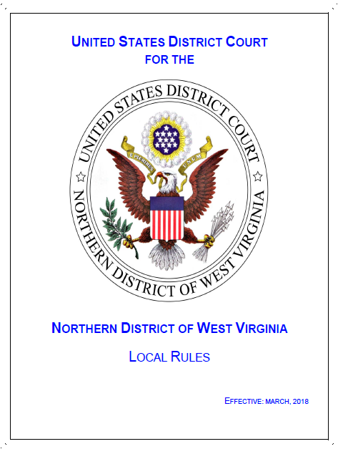

Slide 6
Southern District of West Virginia
Attorneys must first be admitted to practice in the Southern District of West Virginia.¹
The Local Rules for the Northern District of West Virginia can be found on the court’s website.²
Bluefield
Senior U.S. District Judge David A. Faber
U.S. Magistrate Judge Omar J. Aboulhosn
Charleston
U.S. District Judge Thomas E. Johnston (Chief Judge)
U.S. District Judge Joseph R. Goodwin
U.S. District Judge Irene C. Berger
U.S. District Judge Frank W. Volk
Senior U.S. District Judge John T. Copenhaver, Jr.
U.S. Magistrate Judge Dwane L. Tinsley
U.S. Magistrate Judge Omar J. Aboulhosn
Huntington
U.S. District Judge Robert C. Chambers
U.S. Magistrate Judge Cheryl A. Eifert
Beckley
U.S. District Judge Frank W. Volk
U.S. Magistrate Judge Omar J. Aboulhosn
Bankruptcy Court³
U.S. Bankruptcy Judge B. McKay Mignault
Clerk of Court
Roy L. Perry
¹ For information about admission, please visit: https://www.wvsd.uscourts.gov/attorney-info.
² Please visit https://www.wvsd.uscourts.gov/, then select “Local Rules” in the upper left corner.
³ For information regarding bankruptcy court, please visit https://www.wvsb.uscourts.gov/.

Slide 7
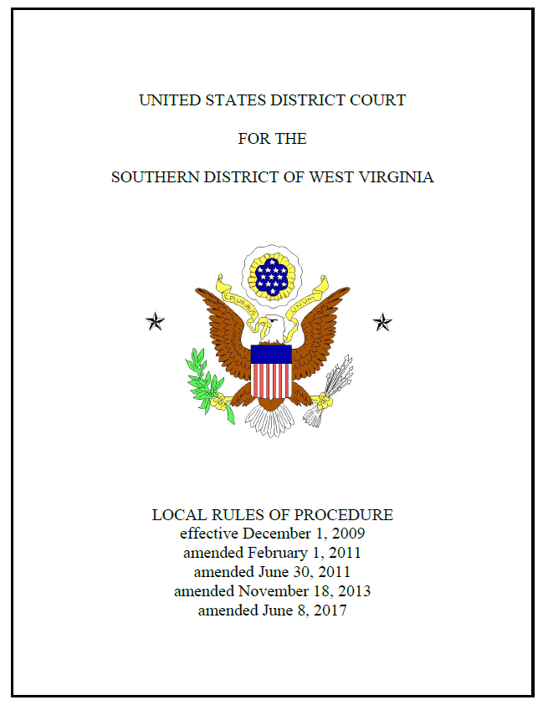

Slide 8
Practice Note
Federal versus State Difference
Please note that U.S. Magistrate Judges are not the federal equivalent of a state magistrate. U.S. Magistrate Judges are referred to as “Judge” or “Your Honor.”
State magistrates have jurisdiction of amounts in dispute of less than $10,000. No such limit exists for a U.S. Magistrate Judges; jurisdiction is provided by 28 U.S.C. § 636.
Under West Virginia law, no education beyond a high school diploma is required to serve as a state magistrate. W. Va. Code § 50-1-4. Whereas, a U.S. Magistrate Judge must generally be a member in good standing of the bar of the highest court of a State or territory of the United States for at least five years prior to appointment to serve the federal courts. 28 U.S.C. § 631. Please see the pamphlets provided by Judge Aloi for information regarding the duties of a U.S. Magistrate Judge.

Slide 9
Practice Note
ALL COURTS – Federal and State
Judicial Assistants, Term Law Clerks, Career Law Clerks, Courtroom Clerks, and Court Reporters play an essential role in the management of a judge’s chambers. These individuals act under the authority of the judge, and attorneys must conduct themselves in an appropriate and respectful manner when communicating with support staff in both state and federal court.

Slide 10
U.S. Court of Appeals for the Fourth Circuit
Includes Maryland, West Virginia, Virginia, North Carolina, and South Carolina. ¹
Fifteen active circuit judges and two senior judges, including the following judges from West Virginia:
Fourth Circuit Court of Appeals Judge Robert B. King
Fourth Circuit Court of Appeals Judge Stephanie D. Thacker
¹ See https://www.ca4.uscourts.gov/home.

Slide 11
CRIMINAL CASES IN FEDERAL COURT
OPPORTUNITIES FOR LAWYERS
CJA PANEL ATTORNEYS
FEDERAL PUBLIC DEFENDERS
ASSISTANT UNITED STATES ATTORNEYS
UNITED STATES PROBATION OFFICERS
SIMILARITIES TO STATE COURT
PREDOMINATE CASES:
DRUGS
PORNOGRAPHY
INTERNET SEX CRIMES
GUNS
SPEEDY TRIAL
LOCAL RULES

Slide 12
Biggest Differences between State and Federal Court Practice
State Court has larger case load
Therefore, less able to move things through system faster
Federal Court is much more rigid on time frames
Don’t assume just because both sides agree to continue, that the case will be continued.
My experience as a Judge in State Court was that I would be able to move cases
Local rules are strictly followed.
Not all motions will get hearings. Many motions will be decided on the pleadings.
Time frames to respond to motions are contained in the local rules and are strictly followed by the Court. You can’t assume that your pleading will be considered if you file it late.
Page limits are also strictly followed unless you get leave to exceed the page limits.
Sanctions For Discovery disputes!!!

Slide 13
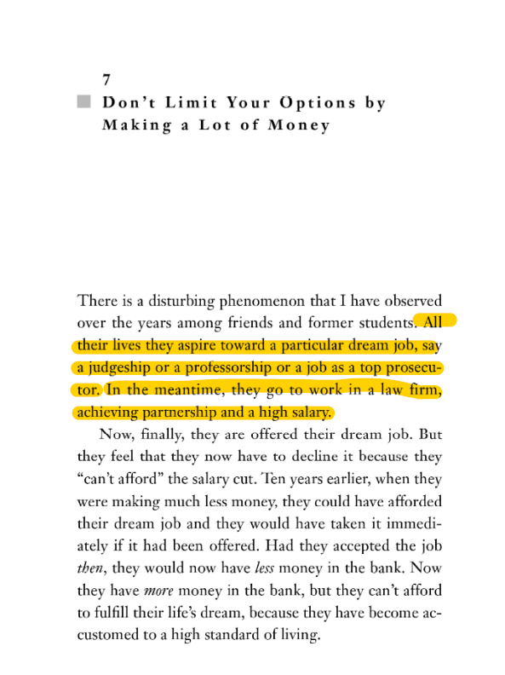
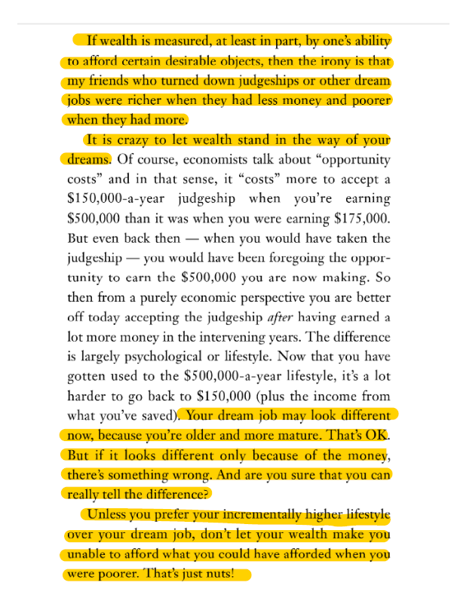
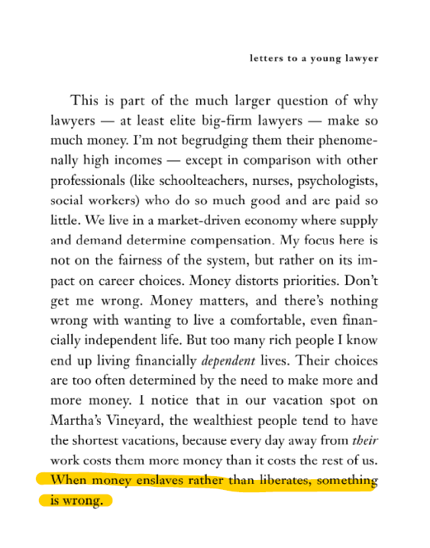
Letters to a Young Lawyer by Alan Dershowitz… Chapter 7

Slide 14
Rule 37(a)(5) Payment of Expenses; Protective Orders.
(A) If the Motion Is Granted (or Disclosure or Discovery Is Provided After Filing). If the motion is granted—or if the disclosure or requested discovery is provided after the motion was filed—the court must, after giving an opportunity to be heard, require the party or deponent whose conduct necessitated the motion, the party or attorney advising that conduct, or both to pay the movant's reasonable expenses incurred in making the motion, including attorney's fees. But the court must not order this payment if:
(i) the movant filed the motion before attempting in good faith to obtain the disclosure or discovery without court action;
(ii) the opposing party's nondisclosure, response, or objection was substantially justified; or
(iii) other circumstances make an award of expenses unjust.

Slide 15
Rule 37(a)(5) Payment of Expenses; Protective Orders.
(B) If the Motion Is Denied. If the motion is denied, the court may issue any protective order authorized under Rule 26(c) and must, after giving an opportunity to be heard, require the movant, the attorney filing the motion, or both to pay the party or deponent who opposed the motion its reasonable expenses incurred in opposing the motion, including attorney's fees. But the court must not order this payment if the motion was substantially justified or other circumstances make an award of expenses unjust.

Slide 16
Rule 37(a)(5) Payment of Expenses; Protective Orders.
(C) If the Motion Is Granted in Part and Denied in Part. If the motion is granted in part and denied in part, the court may issue any protective order authorized under Rule 26(c) and may, after giving an opportunity to be heard, apportion the reasonable expenses for the motion.

Slide 17
Hints for successful Discovery Conferences
1. REMEMBER WHO YOUR AUDIENCE WILL BE!!!
When sending emails/letters to opposing counsel, ALWAYS assume that the communication will be read by the Judge!!
Being uncivil to opposing counsel will not play well with the Judge.
Making ABSOLUTE assumptions about how the Court will rule on a matter will not play well with the Judge.
2. You must have a meaningful GOOD FAITH attempt at resolution of the dispute BEFORE coming to Court.
Judges will hold both sides responsible for failing to do this.
Document, Document, DOCUMENT all the steps you took to try and have a GOOD FAITH attempt with opposing Counsel.

Slide 18
Hints for Successful Discovery Conferences
3. Remember to review the local rules!!!
4. Timelines are important and will NOT be modified without an extraordinary showing of need.
NEVER assume that the Court will extend or modify the schedule just because the parties agree!!!
Best Practice is to ASSUME that the schedule WILL NOT be modified!!
5. You must know how the District has ruled on similar matters before. Citing out-of-District cases when there are ON-POINT local District Cases is INSANE!!!

Slide 19
Top Secret Hints about MJ Aboulhosn
Nearly ALWAYS requires an informal (off the record) conference with the parties’ counsel regarding discovery motions (Motions to Compel; Motions for Sanctions; Motions for Protective Orders). GENERALLY HELD WITHIN DAYS OF MOTION BEING FILED.
Purpose: Save the Parties Time and Money.
Reduces the filing of formal responses and on the record hearings;
Most of the Time it Eliminates the requirement of Rule 37 Sanctions being awarded
Nearly ALWAYS gives great hints about how he would rule on the matters if formal (on the record) hearing had to be conducted.
If you listen carefully, he telegraphs his balls and strike calls during the conference!!!

Slide 20
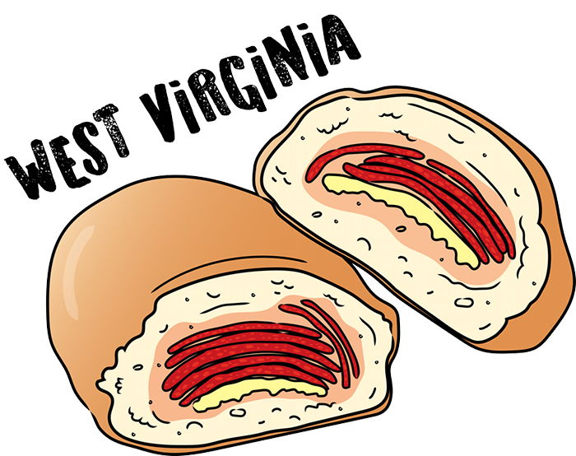
Top Secret Hints about MJ Aloi
Expects you to always be respectful to all persons in the courtroom.
Will ALWAYS ask the parties if you conferred first on civil discovery matters; if no, beware, Judge Aloi will stop the hearing and make you confer on the spot. Everything is a mediation.
Purpose: Conferring prior to the filing of discovery motions and throughout the process saves time.
Always happy to conduct proceedings by Zoom to save time and travel for parties and their counsel.
If proceedings are protracted enough and timed correctly, pepperoni rolls may be offered.
Bonus points: if you can name what’s “wrong” with this pepperoni roll. Artist credit: Liz Pavlovic.

Slide 21
QUESTIONS OR COMMENTS?
Thank you!

