Slide 1
Generative AI, Plagiarism, and Copyright Infringement in Legal Documents
Amy b cyphert
West virginia university college of law

Slide 2
Outline of presentation
Important technical concepts for generative AI
Generative AI and plagiarism?
Generative AI and copyright
Implications for lawyers
Best practices moving forward
PPT Stock Image

Slide 3
Three Important technical concepts
Massive data training sets
Can be intentionally prompted to reproduce whole passages of copyright works
“Unintentional regurgitation”
PPT Stock Image

Slide 4
Plagiarism?
Law students vs. lawyers
What judges and disciplinary councils say about lawyers’ “plagiarism”

Slide 5
Copyright infringement?
Plaintiffs’ theories to date:
The scraping/copying to train as infringement
The training as infringement
All outputs as infringement
Selected outputs as infringement
PPT Stock Image

Slide 6
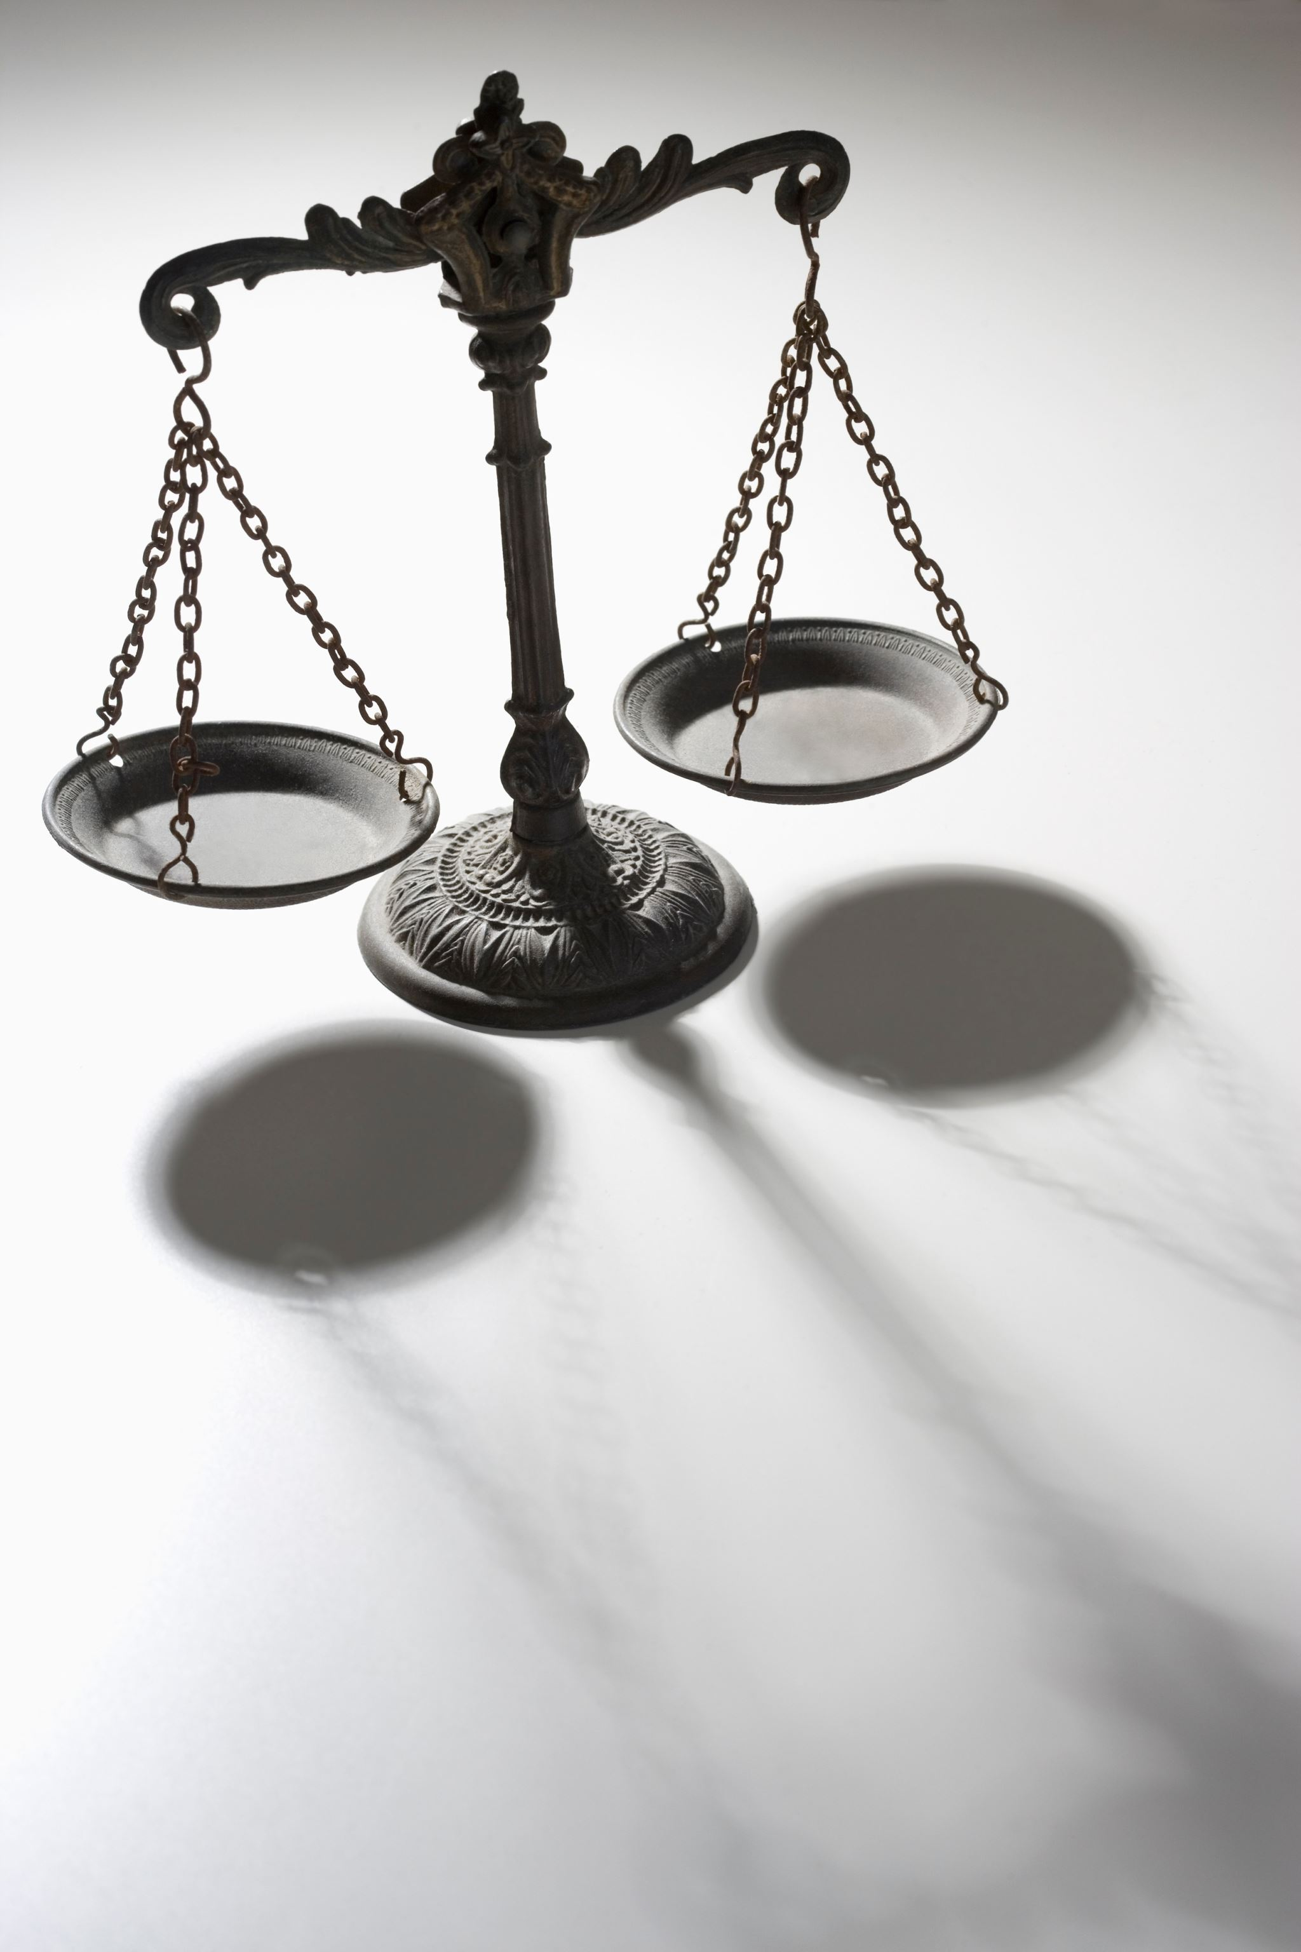
What are the potential negative implications for lawyers?
Potential embarrassment
Malpractice claim
Sanctions
Professional discipline
Copyright infringement lawsuit?
PPT Stock Image

Slide 7
Best practices moving forward
Importance of being aware of BOTH AI hallucinations and possibility of regurgitation
Finding the use that is both professional and ethical.
PPT Stock Image

Slide 8
Questions?
To learn more, check out Amy Cyphert, Generative AI, Plagiarism, and Copyright for Lawyers, Minnesota Journal of Law, Science & Technology, forthcoming
PPT Stock Image

